Slide 1

Asp.Net Core MVC

Slide 2
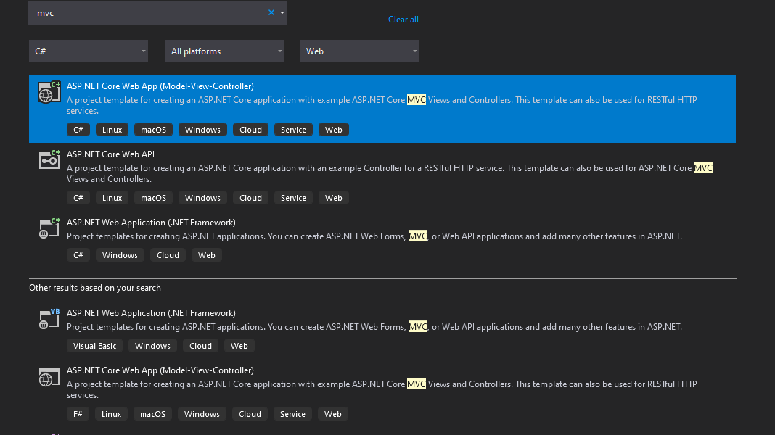

Slide 3
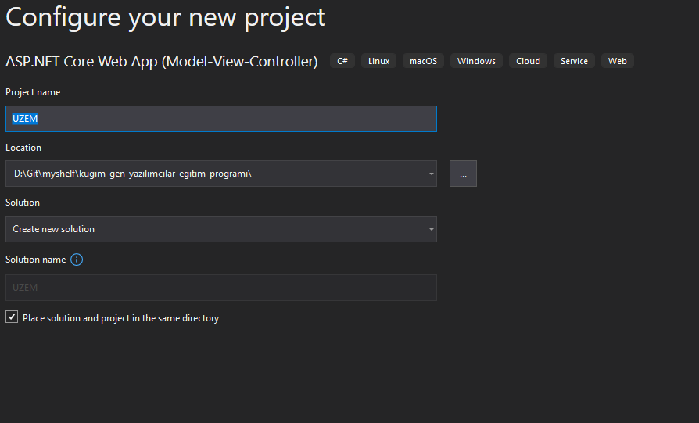

Slide 4
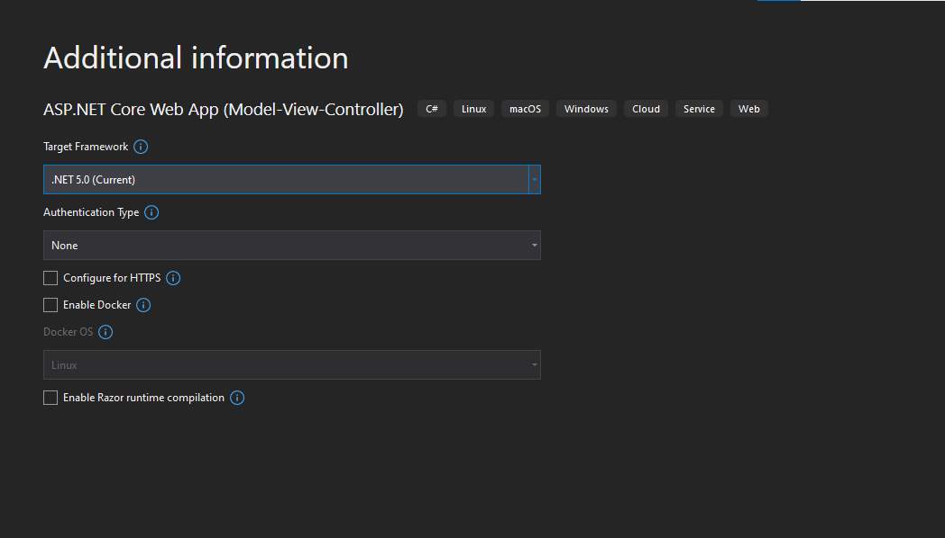

Slide 5
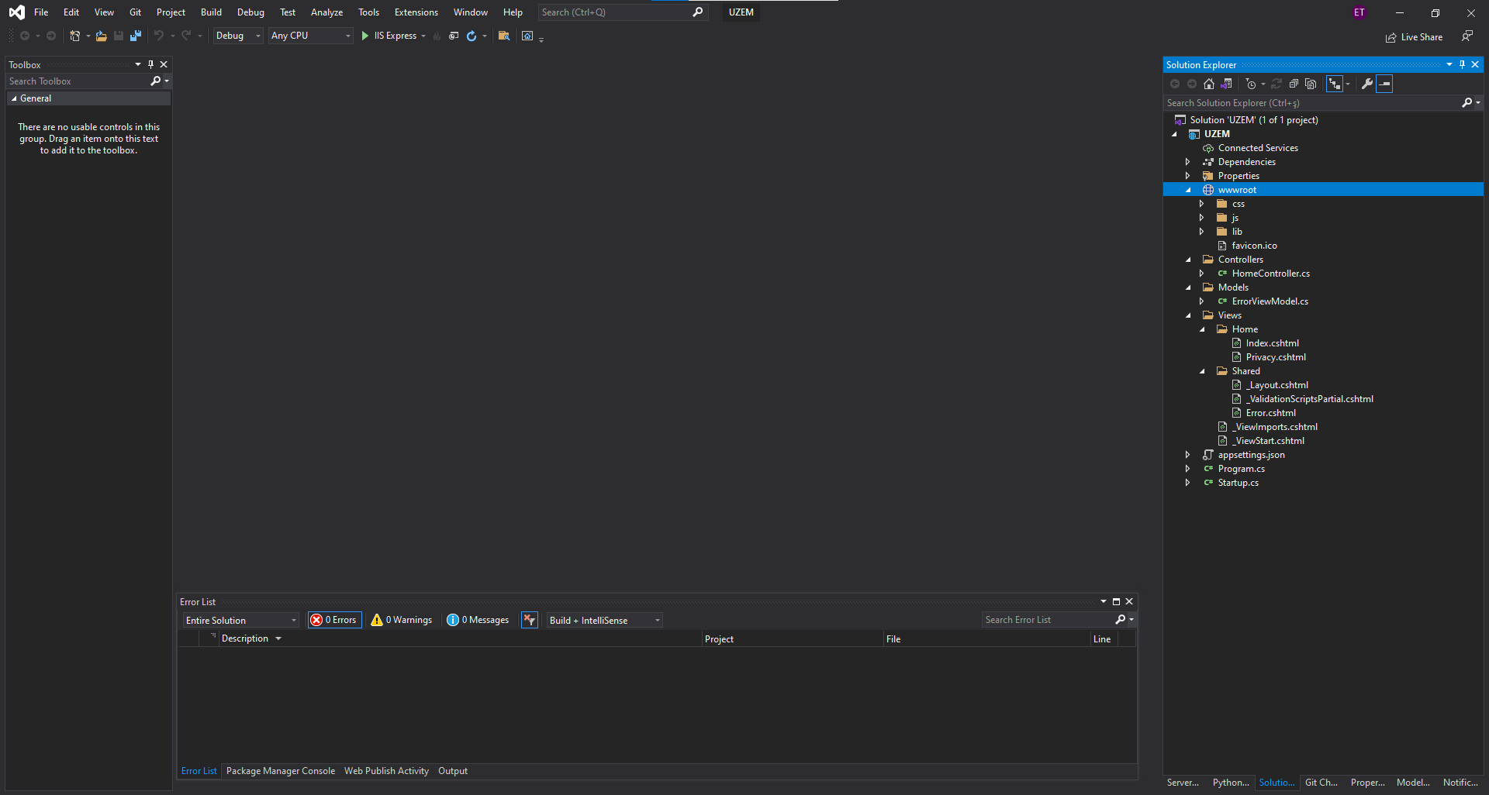

Slide 6
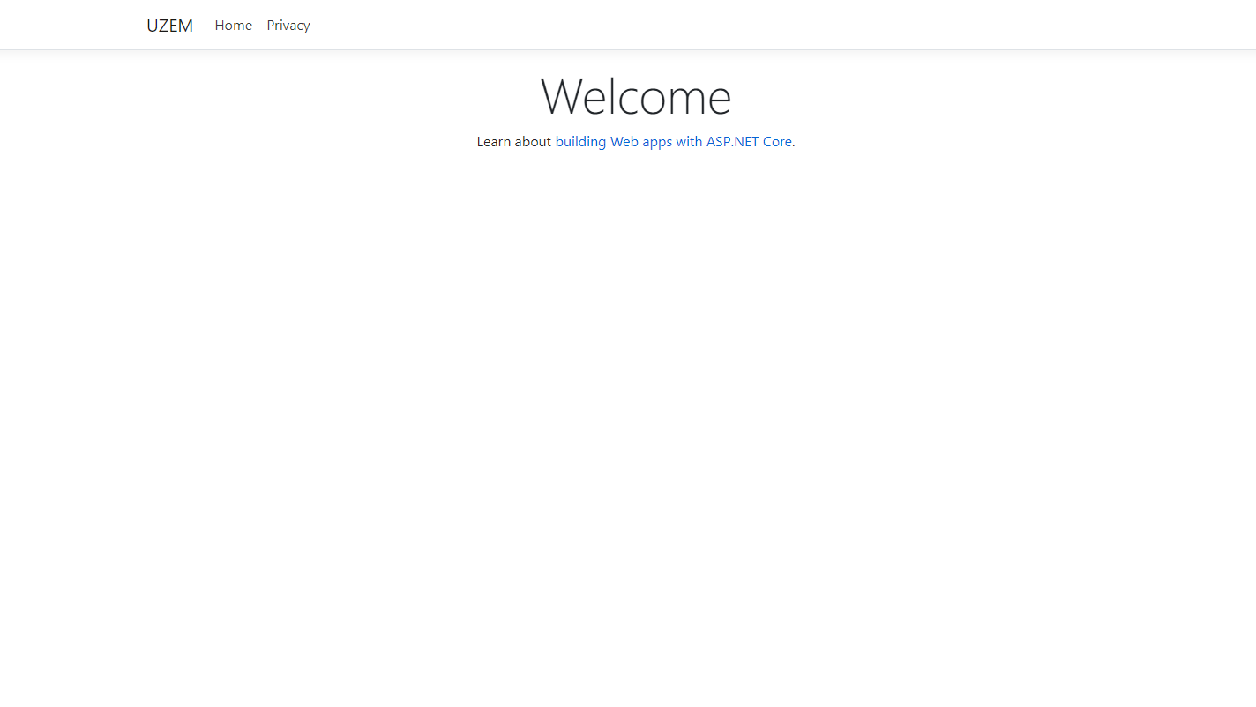

Slide 7
Controller Yapısı
public class HomeController : Controller
{
public IActionResult Index(int id)
{
...
}
}

Slide 8
Model bağlama
public async Task<IActionResult> Login(LoginViewModel model) {
...
}

Slide 9
Model doğrulaması
using System.ComponentModel.DataAnnotations;
public class LoginViewModel
{
[Required]
[EmailAddress]
public string Email { get; set; }
[Required]
[DataType(DataType.Password)]
public string Password { get; set; }
[Display(Name = "Remember me?")]
public bool RememberMe { get; set; }
}

Slide 15

Teşekkürler!
birisi@example.com

